Slide 1

North American University Advanced Cloud Computing Final Project
Advisor:
PhD. Mahbubur Rahman
Mergen Paltayev
Aysel Dalcicek
Sema Yartasi

Slide 2

Create an instance at AWS

Slide 3
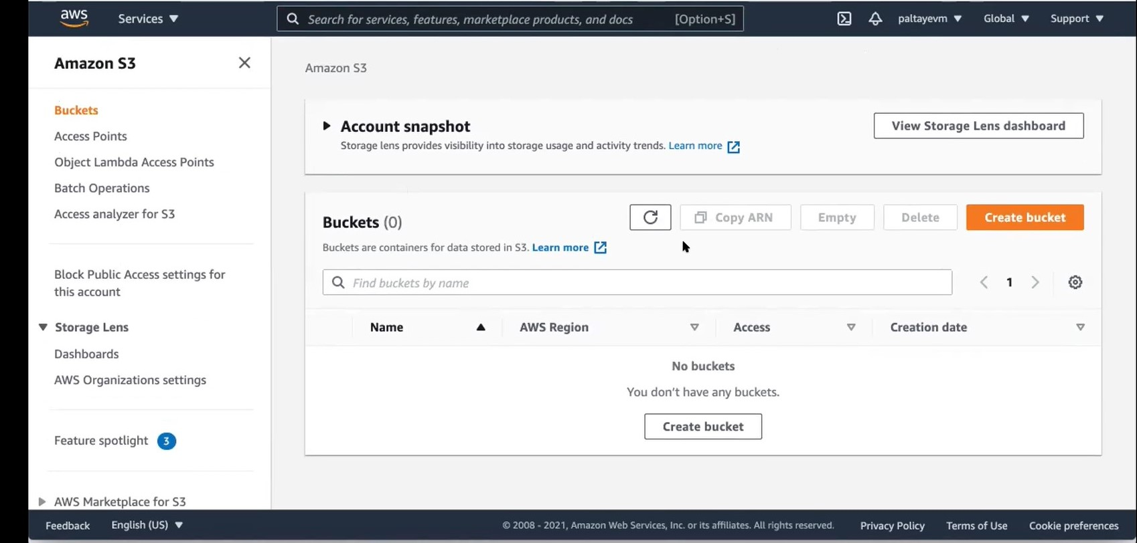
Create an instance at AWS
Notes:
Amazon Simple Storage Service (Amazon S3) is a global Infrastructure as a Service (IaaS) solution provided by Amazon Web Services (AWS),secured and low-latency data storage from the cloud.
Allows unlimited data and object storage of most data types in a variety of formats. A stored data set, which is an object, ranges from 1 B to 5 TB.
Strong authentication ensures the security of regionally stored data.

Slide 4
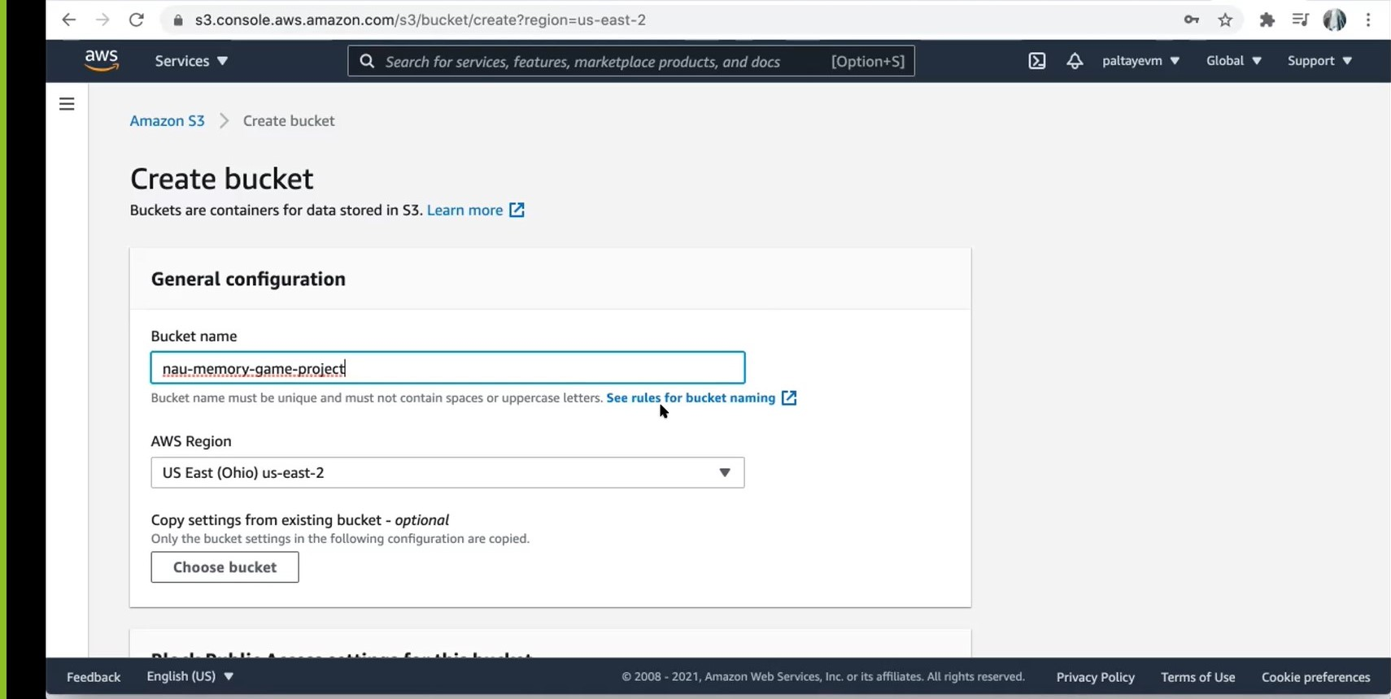
Create Bucket
Notes:
An Amazon S3 bucket is a public cloud storage resource available in Amazon Web Services' (AWS) Simple Storage Service (S3), an object storage offering. Amazon S3 buckets, which are similar to file folders, store objects, which consist of data and its descriptive metadata.
An S3 customer first creates a bucket in the AWS region of his or her choice and gives it a globally unique name. AWS recommends that customers choose regions geographically close to them to reduce latency and costs.
An AWS customer can interact with an Amazon S3 bucket via the AWS Management Console, AWS Command Line Interface or application programming interfaces (APIs).

Slide 5
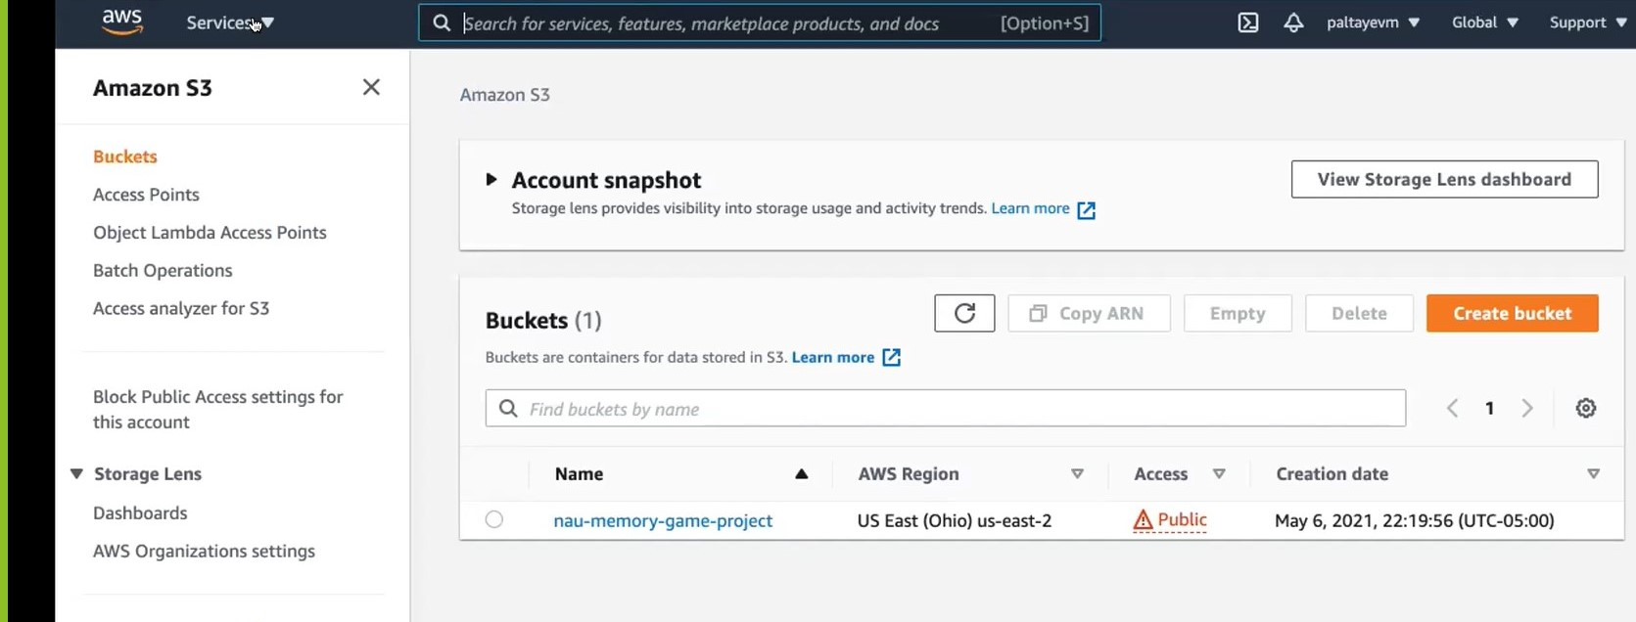
S3 Bucket created successfully

Slide 6
Deploy the software service to the instance using AWS

Slide 7
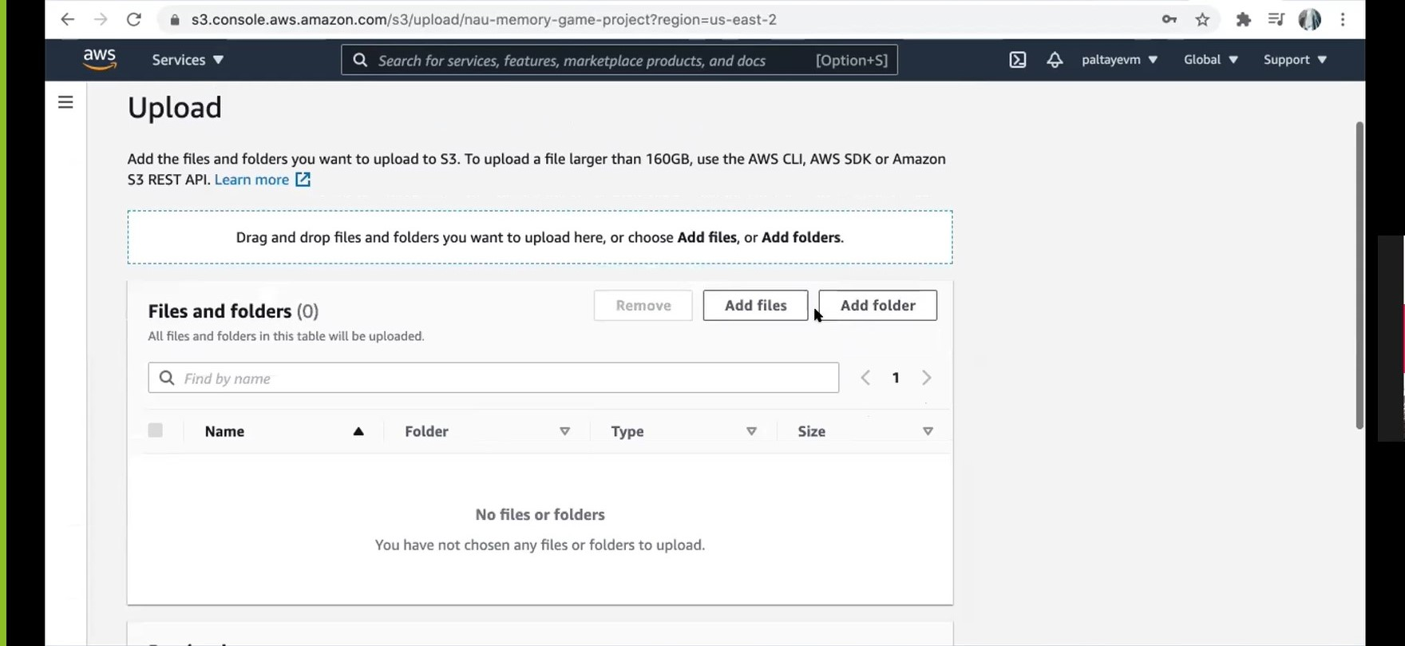
Upload files and folder to S3

Slide 8
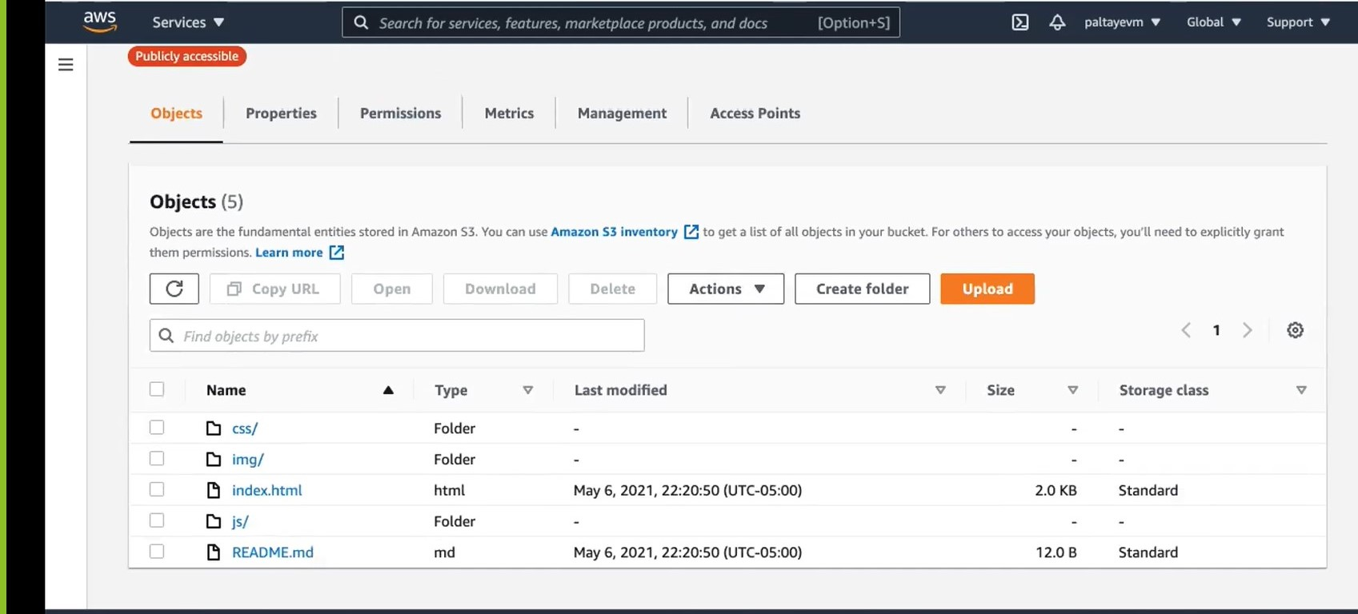
Objects are the fundamentals entities stored in Amazon S3

Slide 9
Provide access point

Slide 10
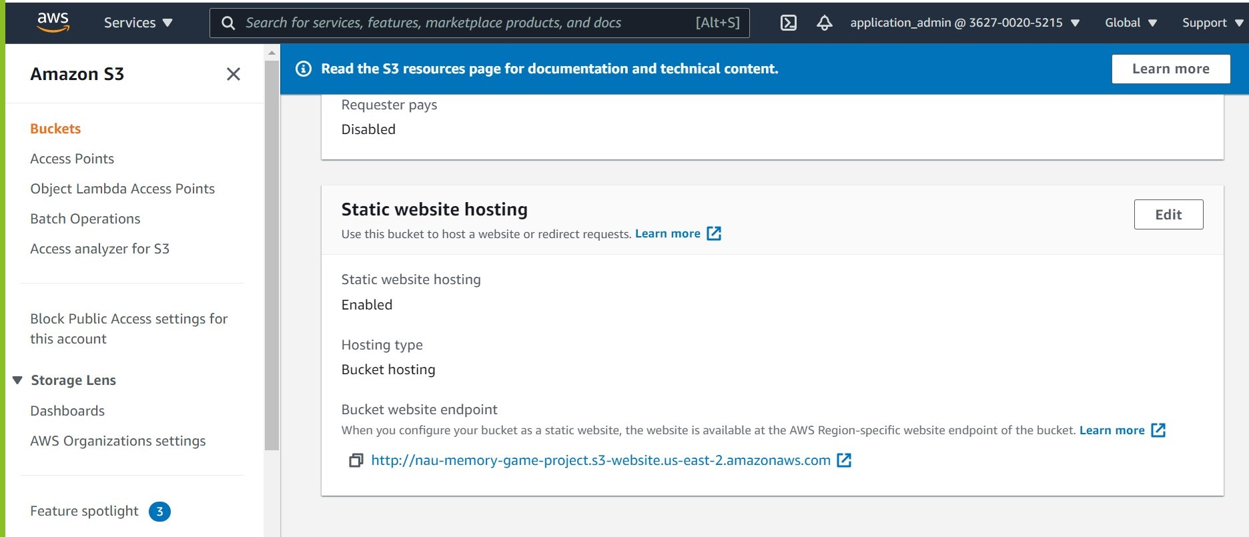
Static websites hosting http://nau-memory-game-project.s3-website.us-east-2.amazonaws.com

Slide 11
Provide secured access to the instance using SSH protocols, clients to the group members
Notes:
The protocol is used in corporate networks for:
providing secure access for users and automated processes
interactive and automated file transfers
issuing remote commands
managing network infrastructure and other mission-critical system components.

Slide 12
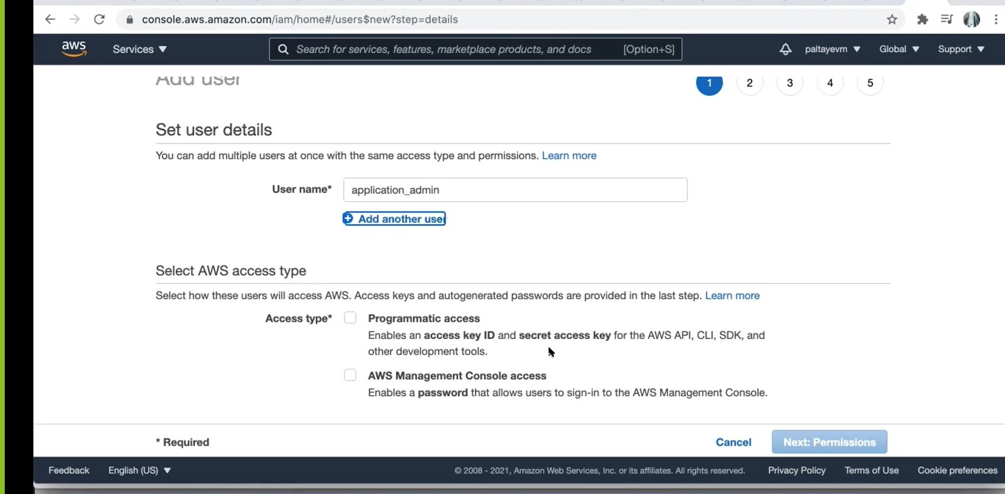
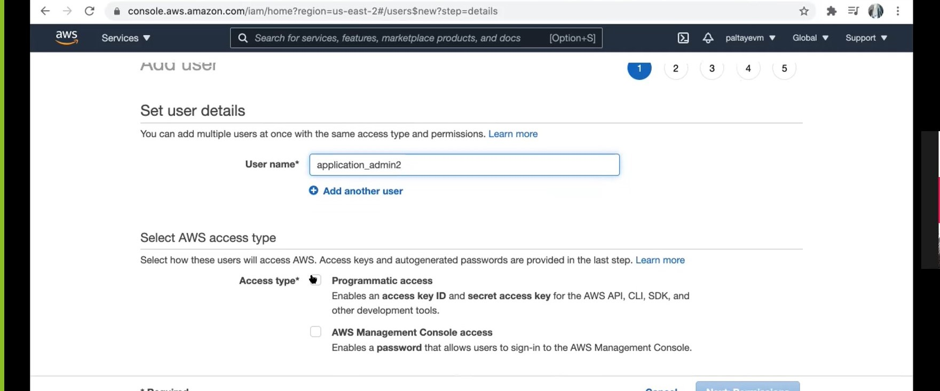
Add Users for access to console

Slide 13
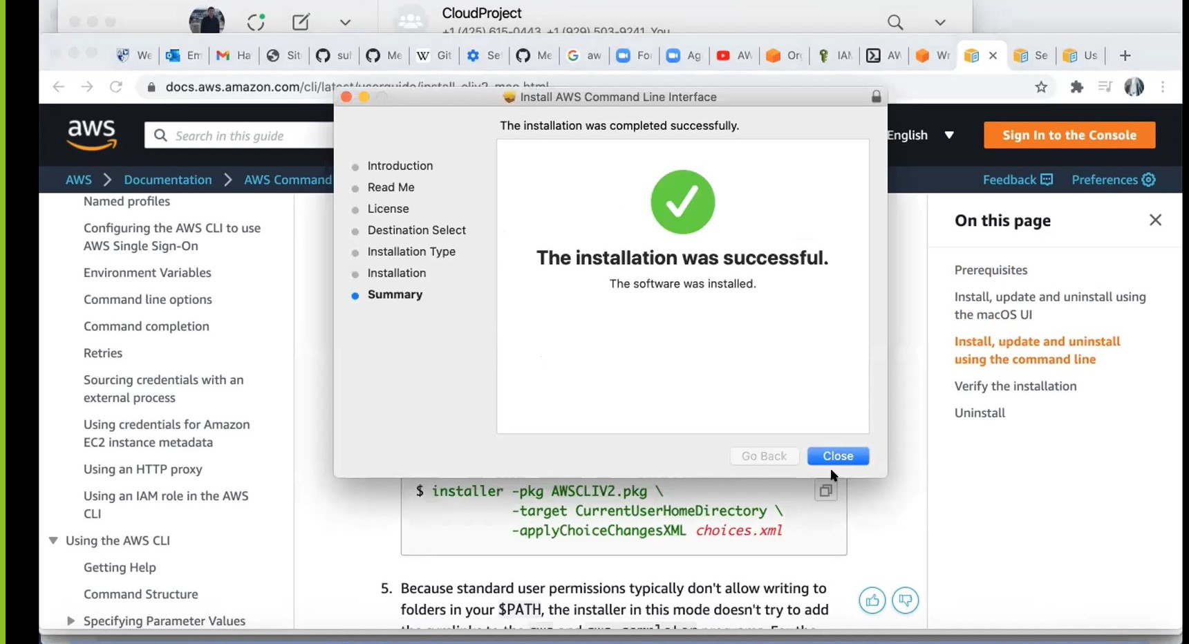
Download the latest version of the AWS CLI

Slide 14
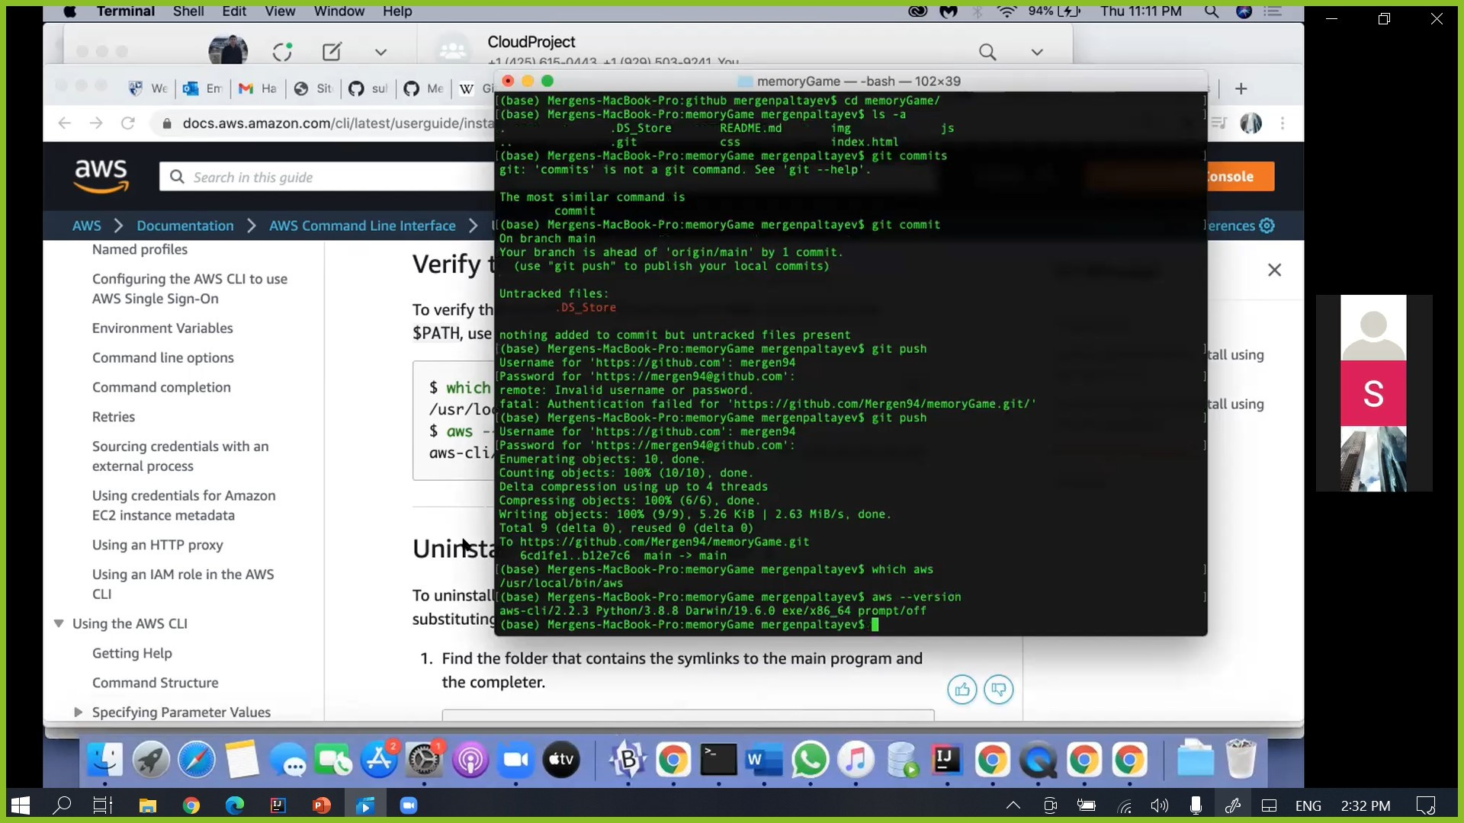
Verify the installation

Slide 15
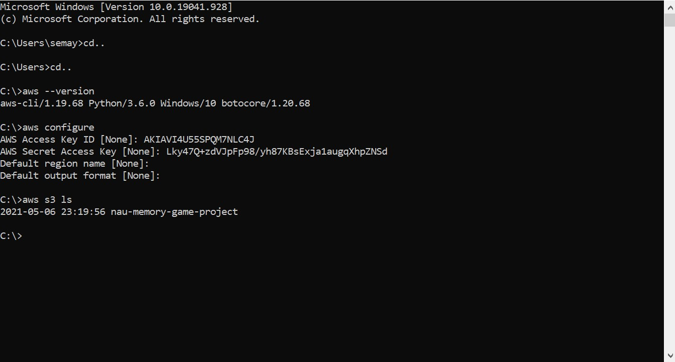
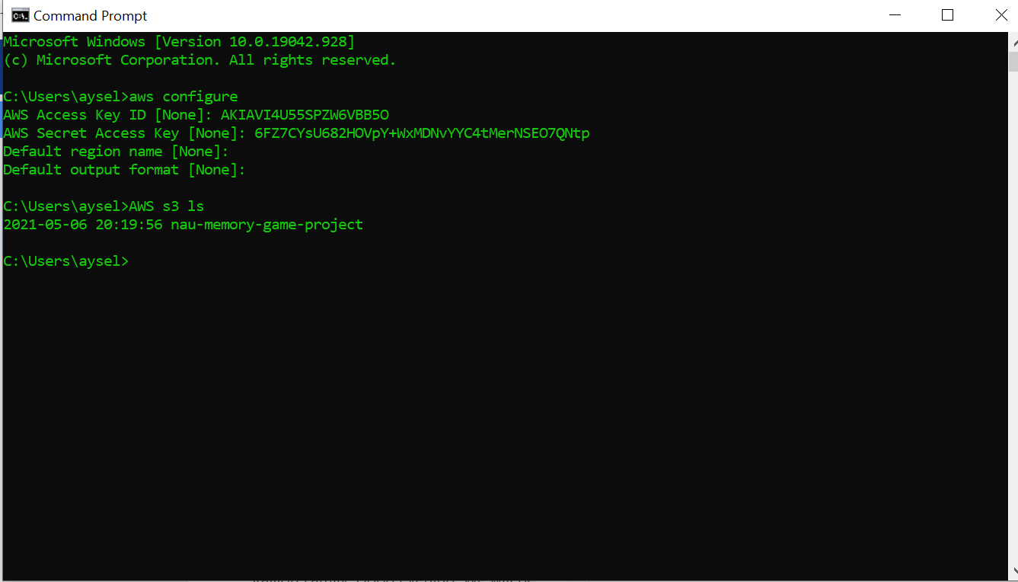
Enter with Generated AWS Access Key ID and Secret Access Key

Slide 16
Run and test the overall services.
https://362700205215.signin.aws.amazon.com/console

Slide 17
Thank you ☺

